Slide 1


Gaussian Mixture Variational Autoencoder with Contrastive Learning for Multi-Label Classification
BY
KANAD SEN (22M1674) & Saksham Gupta(20D170037)
Guided by: prof. Balamurugan palappian
IE 643

Slide 2
Outline of the presentation
Introduction
Understanding Multimodal and Multi-Label Data
Understanding multi-label multi-class classification
Which VAE?
Difference between AE and VAE
Over-view of the Auto-Encoding Variational Bayes
Difference between VAE’s and GAN’s
Gaussian Mixture Latent Space
Distance Metrics of Probability Distribution
ELBO Method (EVIDENCE lower bound loss method)
Performance metrics used
References

Slide 3
Introduction
The project is aimed at creating a state of the art VAE model for multimodal use cases. Some of the real word applications for the same are given :
Uses of Multimodal Deep Learning Models:
Multimodal deep learning models refer to models that can process and analyze information from multiple modalities, such as text, images, audio, and video. These models have a wide range of applications across various fields. Here are some of the key uses of multimodal deep learning models
Emotion Recognition: By processing both facial expressions (images) and speech patterns (audio), multimodal models can infer emotions, which is useful in applications like sentiment analysis, customer service, and mental health monitoring.
Healthcare: These models can analyze a combination of medical images, patient records, and text reports for tasks such as disease diagnosis, anomaly detection, and personalized treatment planning.
Autonomous Vehicles: Multimodal models can process data from various sensors like cameras, LiDAR, and GPS to help autonomous vehicles understand their environment and make decisions.
VAEs and their usage:
Variational Autoencoders (VAEs) are a type of generative model that combine ideas from both autoencoders and variational inference. They have a wide range of applications in various fields. Here are some of the key usages of VAEs:
Image Generation: VAEs can generate realistic images from random noise by learning a probabilistic mapping from a latent space to the data space. This is widely used in generative art, image synthesis, and data augmentation.
Data Denoising: VAEs can be used to denoise noisy or corrupted data by training the model to learn the underlying structure of the data while ignoring the noise.
Anomaly Detection: VAEs can be used to identify anomalous data points by training the model on normal data and then using it to detect deviations from this learned distribution.

Slide 4
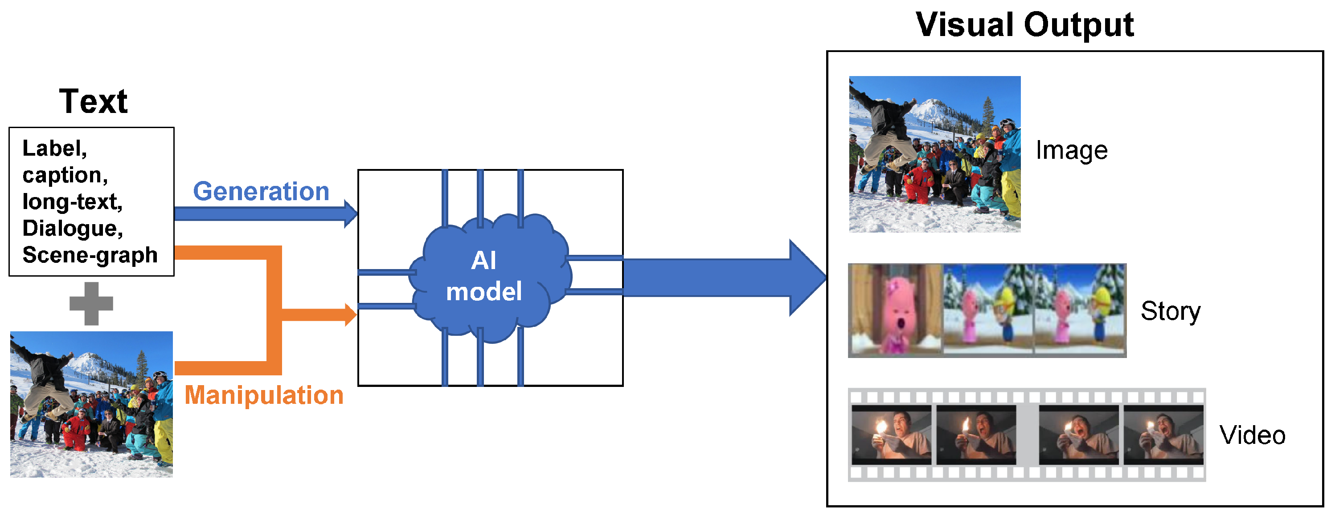
Understanding Multimodal and Multi-Label Data
Multimodal Data:.
Refers to data that encompasses multiple types or modes, such as text, images, audio, etc.
Examples include captioned images, videos with transcripts, and sensor data with annotations.
Real-World Applications: Image Captioning (Text + Image), Medical Diagnosis (Image + File Records), Sentiment Analysis (Speech + Text), etc..
Fig 1: Multi-modal Learning[]

Slide 5
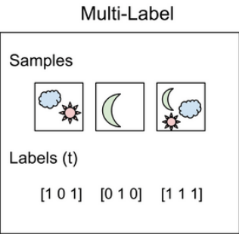
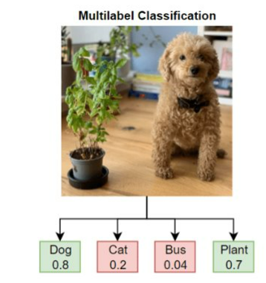
Understanding multi-label multi-class classifiaction
Multi-Label Classification:
Involves assigning multiple labels or categories to a single instance.
Applicable in scenarios where an instance may belong to multiple classes simultaneously.
Real-World Applications: Document Categorization, Image Tagging, Medical Treatment Planning
Fig 2: Multi Label and Multi-class and Multi-Label classification[2]

Slide 6
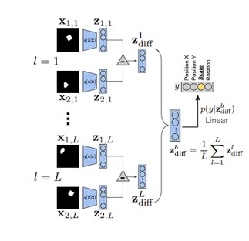
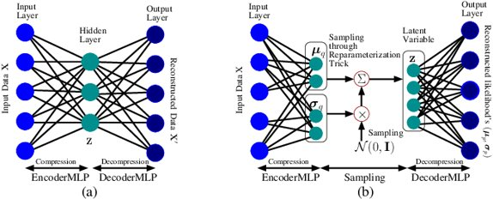
Which VAE?
Vanilla Variational Autoencoder (VAE) It comprises an encoder network that maps input data to a probability distribution in the latent space, and a decoder network that reconstructs the data from samples drawn from the latent space. It minimizes the reconstruction loss (usually measured by the binary cross-entropy for binary data or mean squared error for continuous data) along with the Kullback - Leibler divergence between the learned latent distribution and a predefined prior.
Advantages: Simplicity and interpretability. Easy to implement and understand.
Limitations: Limited expressiveness in capturing complex distributions.
Beta- Variational AutoEncoder (β-VAE) β-Variational Auto-Encoder introduces a hyperparameter (β) that balances the trade-off between reconstruction accuracy and the disentanglement of latent variables. This modification aims to learn more interpretable and disentangled representations. Extends the Vanilla VAE loss with a β-weighted term.
Advantages Allows for better control over the disentanglement of learned representations.
Limitations The choice of β requires careful tuning and might not always lead to improved results.

Slide 7
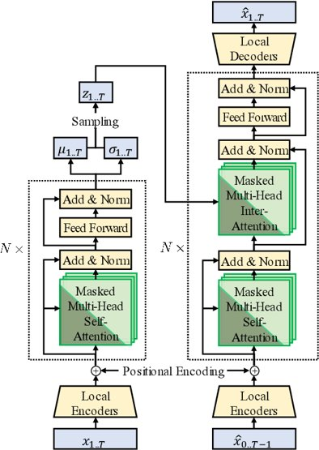
Which VAE?
Transformer Variational Autoencoder (T-VAE)
The Transformer Variational Autoencoder (T-VAE) is an extension of the Vanilla VAE that incorporates the Transformer architecture, originally designed for sequence-to-sequence tasks, into the VAE framework. This integration allows for improved modeling of complex data distributions, making it particularly effective for tasks involving sequential or structured data.
Advantages: The Transformer architecture enables effective handling of sequential or structured data, making T-VAE well-suited for tasks involving text, time series, and other ordered data. Capable of capturing complex dependencies over extended sequences, which may be challenging for standard neural networks. The Transformer architecture's self-attention mechanism allows for a high degree of expressiveness in modeling intricate relationships within the data.
Limitations: Implementing and training a T-VAE can be more involved compared to standard VAEs due to the intricacies of the Transformer architecture. While the T-VAE may excel in capturing complex distributions, the interpretability of the learned representations might be more challenging due to the nature of the Transformer's attention mechanisms.
Fig 3: Transformer VAE[5]

Slide 8
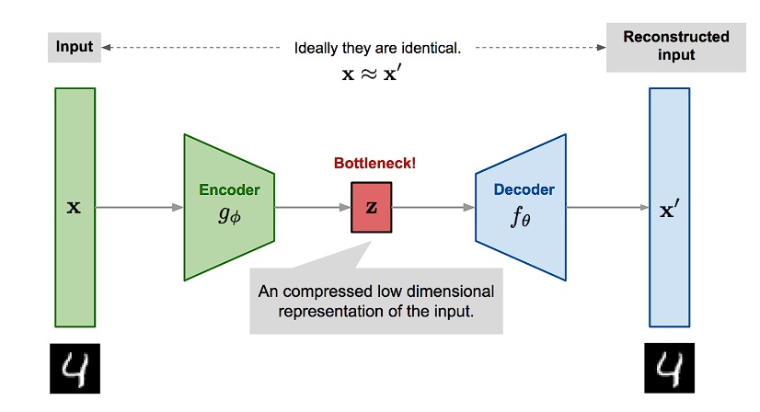
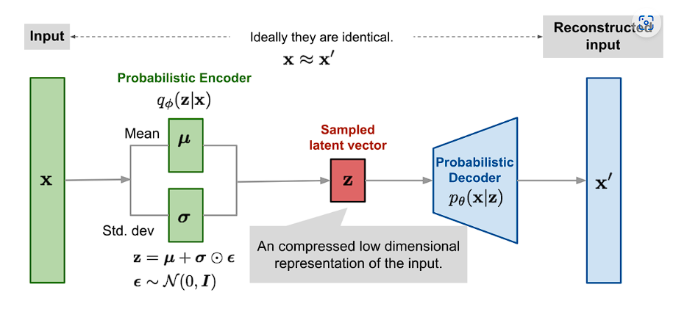
Difference between ae and vae
AUTO-ENCODER :
Autoencoder is a neural network designed to learn an identity function in an unsupervised way to reconstruct the original input while compressing the data in the process so as to discover a more efficient and compressed representation.
It consists of two networks:
Encoder network: It translates the original high-dimension input into the latent low-dimensional code. The input size is larger than the output size.
Decoder network: The decoder network recovers the data from the code, likely with larger and larger output layers.
VARIATIONAL AUTO-ENCODER :
The idea of Variational Autoencoder , short for VAE, is actually less similar to all the autoencoder models above, but deeply rooted in the methods of variational Bayesian and graphical model. Instead of mapping the input into a fixed vector, we want to map it into a distribution.
The relationship between the input x and the latent space z is defined by 3 terms: Prior, Likelihood and Posterior.
Fig 4: Diagram of AE and VAE [6]

Slide 9
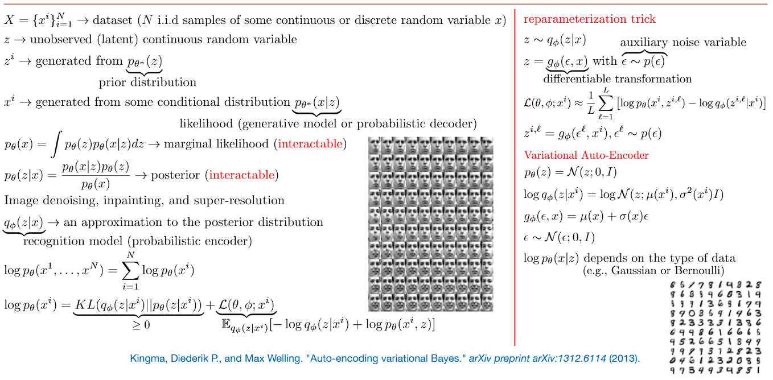
Over-view of the auto encoding variational bayes

Slide 10
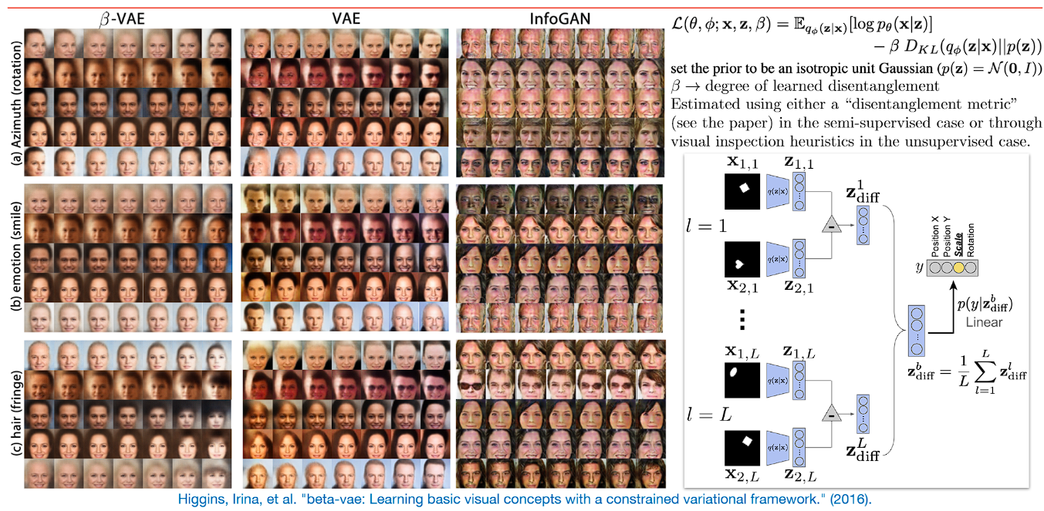
Difference between Vae’s and gans
Fig 5: Beta VAE and Info GAN difference[4]

Slide 11
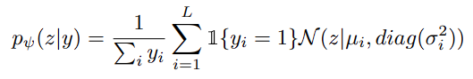
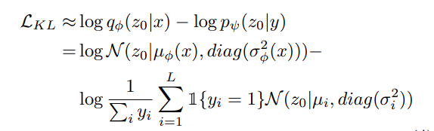
Gaussian Mixture latent space
C-GMVAE inherits the general VAE framework, but with a learnable Gaussian mixture (GM) prior. During training, each sample’s label set activates and mixes the positive Gaussian subspaces to derive the prior. Contrastive learning is applied to boost the embedding learning, using a contrastive loss between the feature and label embeddings.
The label categories car, sea,..., bird are transformed to embeddings first. Embeddings are then passed directly to label encoder rather than summed up. Each label category (e.g., car) corresponds to a unimodal Gaussian in the latent space. y activates “positive” Gaussians (y^{i} = 1) and forms a Gaussian mixture subspace. Given a random variable z ∈ R^{d} , the probability density function (PDF) in the subspace is defined as:
We form a standard posterior in our model and match it with the prior. However, unlike vanilla VAE, we cannot analytically compute the KL term. Instead, we use the following estimation:

Slide 12
Distance Metrics of probability distribution
In the current paper, we have used KL divergence function to measure the alignment of the two latent spaces such that the sampled z belongs to both the label latent space as well as image embeddings latent space.
Jensen Shannon divergence: The Jensen-Shannon divergence is a measure of the “distance” between two probability distributions. It can be thought of as a measure of the similarity or dissimilarity between the two distributions. The JSD is always non-negative, with a value of 0 indicating that the two distributions are identical, and a value greater than 0 indicating that the two distributions are different. The JSD is based on the KL divergence, which is a measure of the difference between two probability distributions. However, the KL divergence is asymmetric, meaning that it depends on which distribution is considered the “reference” distribution and which is considered the “comparison” distribution. The Jensen-Shannon divergence is a symmetrized version of the KL divergence, which allows it to be used to compare any two probability distributions, regardless of which distribution is considered the “reference” and which is considered the “comparison.” The Jensen-Shannon divergence between two probability distributions, P and Q, is defined as:
JSD(P || Q) = (KL(P || M) + KL(Q || M)) / 2 M=(P+Q)/2
Wasserstein Distance Metric: Wasserstein Distance is a measure of the distance between two probability distributions. It is also called Earth Mover’s distance, short for EM distance, because informally it can be interpreted as the minimum energy cost of moving and transforming a pile of dirt in the shape of one probability distribution to the shape of the other distribution. Unlike the KL divergence, the Wasserstein metric is a true probability metric and considers both the probability of and the distance between various outcome events. Unlike other distance metrics like KL-divergence, Wasserstein distance provide a meaningful and smooth representation of the distance between distributions. These properties make the Wasserstein well-suited to domains where an underlying similarity in outcome is more important than exactly matching likelihoods.

Slide 13
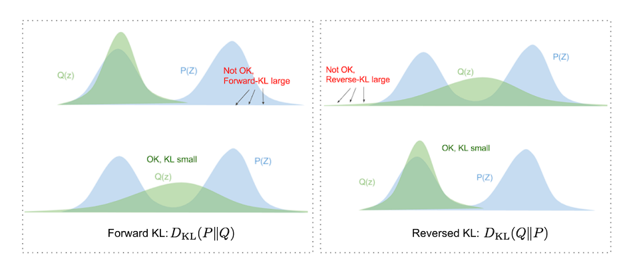
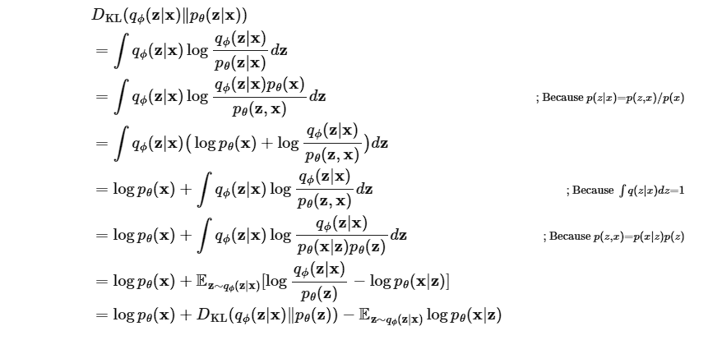
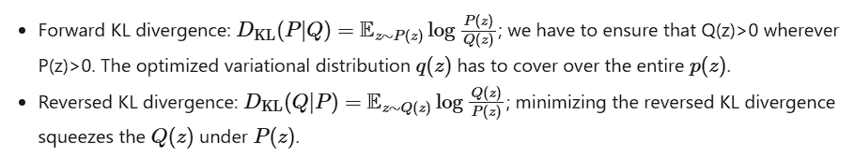
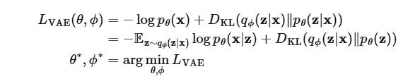
ELBO Method (EVIDENCE lower bound loss method)
Fig 6: Difference between taking Forward KL and Reversed KL [7]
In case of VAE’s we use Reversed KL instead of KL divergence. The illustration shown above is the reason why we use Reverse KL divergence in VAE because we want to limit the space of Q(z) inside the P(z) and not expand it.
Final the loss function becomes:

Slide 14
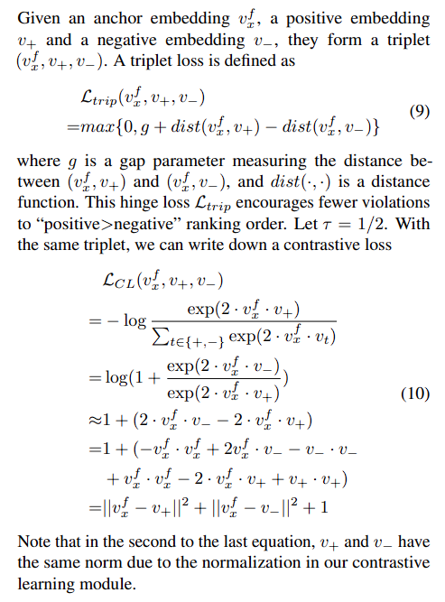
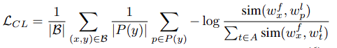
Contrastive loss function
The goal of contrastive representation learning is to learn such an embedding space in which similar sample pairs stay close to each other while dissimilar ones are far apart. Contrastive learning can be applied to both supervised and unsupervised settings. When working with unsupervised data, contrastive learning is one of the most powerful approaches in self-supervised learning.
From the equations as shown here, we can see that the contrastive loss is actually a generalized version of the triplet loss which is derived. The final contrastive loss becomes as :
Here, sim(·) is a function measuring the similarity between two embeddings, and w^{f}_{x} , w^{l}_{p} denote the feature and label embeddings respectively

Slide 15
Performance metrics used
HA (Hamming Accuracy):
Hamming Accuracy is a metric used in multi-label classification tasks. It measures the ratio of correctly predicted labsels to the total number of labels across all samples.
In other words, it evaluates how many of the predicted labels match the true labels for a given sample.
For example, if a sample has three labels and the model predicts two out of three correctly, the Hamming Accuracy for that sample would be 0.67, while the base accuracy would be 0.
ebF1 (Exact Match F1 Score):
The Exact Match F1 Score is used in multi-label classification tasks to measure how well the model predicts the exact set of labels for a given sample.
It calculates the harmonic mean of precision and recall for each sample.
Precision is the ratio of true positives to the sum of true positives and false positives. Recall is the ratio of true positives to the sum of true positives and false negatives.
miF1 (Micro-averaged F1 Score):
The Micro-averaged F1 Score is another metric used in multi-label classification tasks. It calculates F1 scores for each label separately and then takes the weighted average based on the number of true positives, false positives, and false negatives.
maF1 (Macro-averaged F1 Score):
The Macro-averaged F1 Score is also used in multi-label classification tasks. It calculates the F1 score for each label and then takes the unweighted average.
p_at_1 (Precision at 1):
Precision at 1 is a metric often used in information retrieval tasks, such as recommendation systems. It measures the precision of the top recommendation for each query.
These metrics are important for assessing the performance of models, especially in tasks like multi-label classification, where there may be multiple correct answers or preferences for each sample or query.

Slide 16
References
Ullah U, Lee J-S, An C-H, Lee H, Park S-Y, Baek R-H, Choi H-C. A Review of Multi-Modal Learning from the Text-Guided Visual Processing Viewpoint. Sensors. 2022; 22(18):6816.
Tsung-Yi Lin, Michael Maire, Serge Belongie, Lubomir Bourdev, Ross Girshick, James Hays, Pietro Perona, Deva Ramanan, C. Lawrence Zitnick, Piotr Dollár. Microsoft COCO: Common Objects in Context. 2015.
Jin, Feng & Sengupta, Arindam & Cao, Siyang. (2020). mmFall: Fall Detection using 4D MmWave Radar and Variational Recurrent Autoencoder.
Zheng, Zhijie, and Wei Ping. Zhang. "β-VAE: Learning Basic Visual Concepts with a Constrained Variational Framework." In International Conference on Neural Information Processing Systems (NeurIPS), 2019.
Liu, Y., Zhao, Y., Li, H., Yang, T., & Guan, Y. (2022). Transformer VAE: A Hierarchical Model for Structure-Aware and Interpretable Music Representation Learning. In Proceedings of the 2022 ACM Multimedia Conference (pp. 4839-4848).
Liu, Y., Zhao, Y., Li, H., Yang, T., & Guan, Y. (2022). Transformer VAE: A Hierarchical Model for Structure-Aware and Interpretable Music Representation Learning. In Proceedings of the 2022 ACM Multimedia Conference (pp. 4839-4848).
Transformer VAE: A Hierarchical Model for Structure-Aware and Interpretable Music Representation Learning" by Yifan Liu, Yuxuan Zhao, Haoyi Li, Tao Yang, and Yi Guan. The paper was published in the Proceedings of the 2022 ACM Multimedia Conference (pp. 4839-4848).

Slide 17
THANK YOU

